Slide 1
Lecture 9: DEADLOCK
Prof Yotov
CS6233
Slides by Prof Sandoval
Some slides derived from : William Stallings, Tanenbaum/Bo, John Regehr and Brendan Dolan-Gavitt
Thanks !!

Slide 2
deadlock
Notes:
All deadlocks involve conflicting needs for resources by two or more processes. A common example is the traffic deadlock. Figure 6.1a shows a situation in which four cars have arrived at a four-way stop intersection at approximately the same time. The four quadrants of the intersection are the resources over which control is needed. In particular, if all four cars wish to go straight through the intersection, the resource requirements are as follows:
• Car 1, traveling north, needs quadrants a and b.
• Car 2 needs quadrants b and c.
• Car 3 needs quadrants c and d.
• Car 4 needs quadrants d and a.
The rule of the road in the United States is that a car at a four-way stop should defer to a car immediately to its right. This rule works if there are only two or three cars at the intersection. For example, if only the northbound and westbound cars arrive at the intersection, the northbound car will wait and the westbound car proceeds. However, if all four cars arrive at about the same time, each will refrain from entering the intersection, this causes a potential deadlock. The deadlock is only potential, not actual, because the necessary resources are available for any of the cars to proceed. If one car eventually does proceed, it can do so.
However, if all four cars ignore the rules and proceed (cautiously) into the
intersection at the same time, then each car seizes one resource (one quadrant) but
cannot proceed because the required second resource has already been seized by
another car. This is an actual deadlock.

Slide 3
Resource Categories
Reusable
can be safely used by only one process at a time and is not depleted by that use
processors, I/O channels, main and secondary memory, devices, and data structures such as files, databases, and semaphores
Consumable
one that can be created (produced) and destroyed (consumed)
interrupts, signals, messages, and information
in I/O buffers
Notes:
Two general categories of resources can be distinguished: reusable and consumable. A reusable resource is one that can be safely used by only one process at a time and is not depleted by that use. Processes obtain resource units that they later release for reuse by other processes. Examples of reusable resources include processors; I/O channels; main and secondary memory; devices; and data structures such as files, databases, and semaphores.
A consumable resource is one that can be created (produced) and destroyed (consumed). Examples of consumable resources are interrupts, signals, messages, and information in I/O buffers.

Slide 4
Example of Two Processes Competing for Reusable Resources
Notes:
As an example of deadlock involving reusable resources, consider two processes that compete for exclusive access to a disk file D and a tape drive T. The programs engage in the operations depicted in Figure 6.4 . Deadlock occurs if each process holds one resource and requests the other. For example, deadlock occurs if the multiprogramming system interleaves the execution of the two processes as follows:
p 0 p 1 q 0 q 1 p 2 q 2
It may appear that this is a programming error rather than a problem for the OS designer. However, we have seen that concurrent program design is challenging. Such deadlocks do occur, and the cause is often embedded in complex program logic, making detection difficult. One strategy for dealing with such a deadlock is to impose system design constraints concerning the order in which resources can be requested.

Slide 5
Example 2: Memory Request
Space is available for allocation of 200Kbytes, and the following sequence of events occur:
Deadlock occurs if both processes progress to their second request
P1
P2
. . .
. . .
Request 80 Kbytes;
Request 70 Kbytes;
. . .
. . .
Request 60 Kbytes;
Request 80 Kbytes;
Notes:
Another example of deadlock with a reusable resource has to do with requests for main memory. Suppose the space available for allocation is 200 Kbytes, and the following sequence of requests occurs: (see diagram)
Deadlock occurs if both processes progress to their second request. If the amount of memory to be requested is not known ahead of time, it is difficult to deal with this type of deadlock by means of system design constraints. The best way to deal with this particular problem is, in effect, to eliminate the possibility by using virtual memory, which is discussed in Chapter 8 .

Slide 6
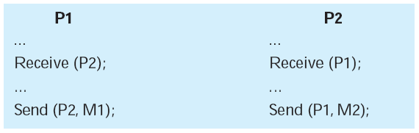
Consumable Resources Deadlock
Consider a pair of processes, in which each process attempts to receive a message from the other process and then send a message to the other process:
Deadlock occurs if the Receive is blocking
Notes:
As an example of deadlock involving consumable resources, consider the following pair of processes, in which each process attempts to receive a message
from the other process and then send a message to the other process: (see diagram)
Deadlock occurs if the Receive is blocking (i.e., the receiving process is blocked until the message is received). Once again, a design error is the cause of the deadlock. Such errors may be quite subtle and difficult to detect. Furthermore, it may take a rare combination of events to cause the deadlock; thus a program could be in use for a considerable period of time, even years, before the deadlock actually occurs.

Slide 7
Deadlocks: Resources
To be general, we'll just think of abstract resources and processes that want to acquire them
We have two flavors:
Non-preemptible: once given, they cannot be taken away without cooperation from the process
Preemptible: we can take it away from the process with no harm done
For example, RAM is preemptible, because we can just swap the pages to disk without the process noticing

Slide 8
Deadlock Definition
We can define a deadlock more formally now: A set of processes is deadlocked if each process in the set is waiting for an event that only another process in the set can cause.

Slide 9
Conditions for Deadlock
Mutual Exclusion
only one process may use a resource at a time
Hold-and-Wait
a process may hold allocated resources while awaiting assignment of others
No Pre-emption
no resource can be forcibly removed from a process holding it
Circular Wait
a closed chain of processes exists, such that each process holds at least one resource needed by the next process in the chain
Notes:
Three conditions of policy must be present for a deadlock to be possible:
1. Mutual exclusion . Only one process may use a resource at a time. No process may access a resource unit that has been allocated to another process.
2. Hold and wait . A process may hold allocated resources while awaiting assignment of other resources.
3. No preemption . No resource can be forcibly removed from a process holding it.
In many ways these conditions are quite desirable. For example, mutual exclusion is needed to ensure consistency of results and the integrity of a database. Similarly, preemption should not be done arbitrarily. For example, when data resources are involved, preemption must be supported by a rollback recovery mechanism, which restores a process and its resources to a suitable previous state from which the process can eventually repeat its actions.
The first three conditions are necessary but not sufficient for a deadlock to exist. For deadlock to actually take place, a fourth condition is required:
4. Circular wait . A closed chain of processes exists, such that each process holds at least one resource needed by the next process in the chain (e.g., Figure 6.5c
and Figure 6.6 ).
The fourth condition is, actually, a potential consequence of the first three. That is, given that the first three conditions exist, a sequence of events may occur that lead to an unresolvable circular wait. The unresolvable circular wait is in fact the definition of deadlock. The circular wait listed as condition 4 is unresolvable because the first three conditions hold. Thus, the four conditions, taken together, constitute necessary and sufficient conditions for deadlock.

Slide 10
Classic synchronization problems

Slide 11
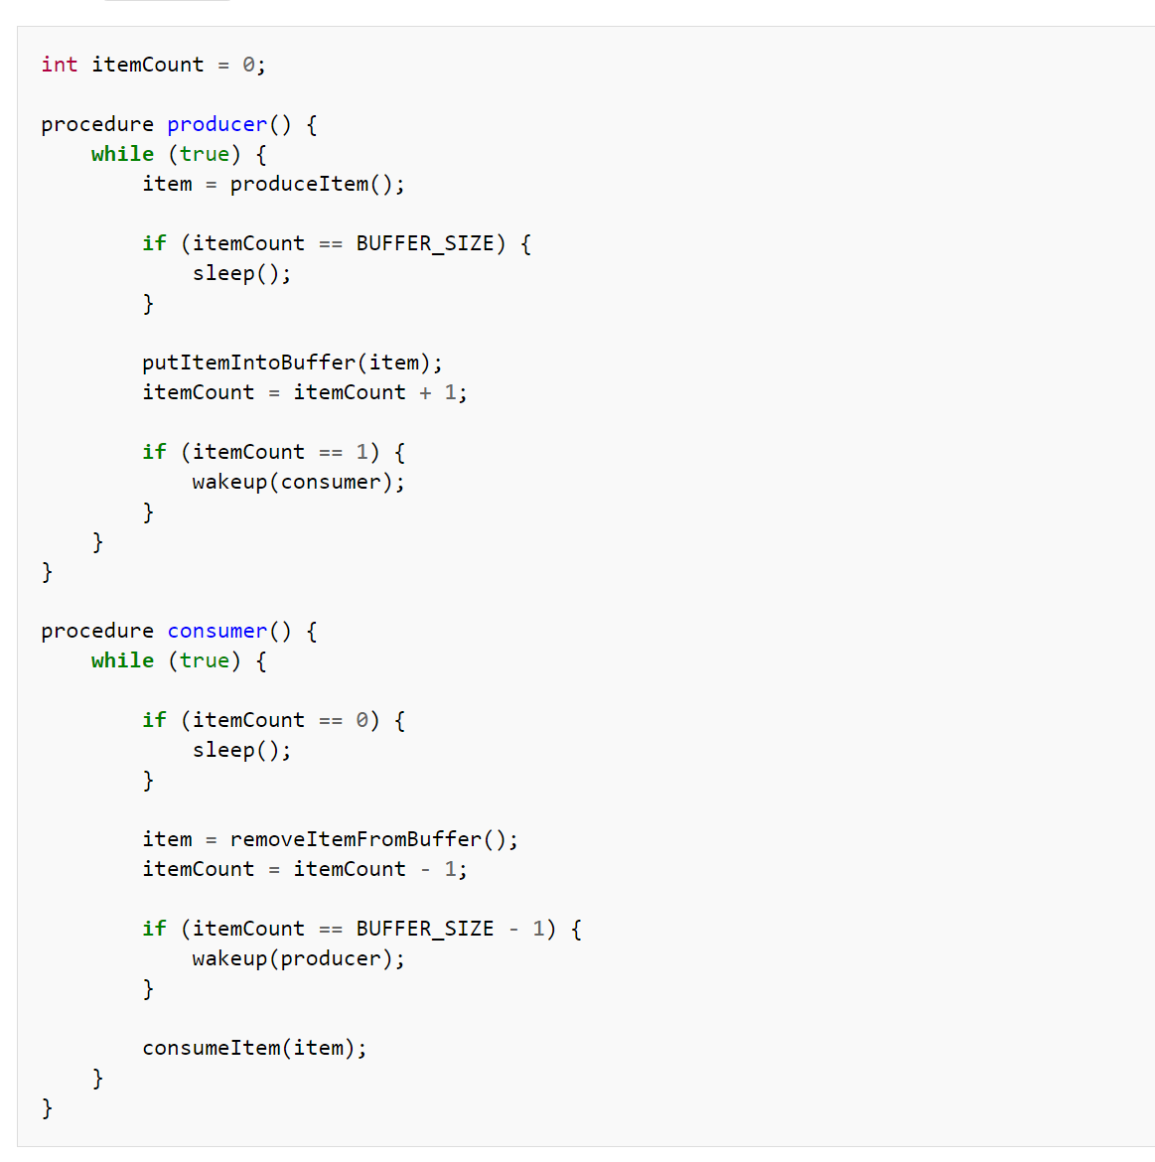
Producer consumer I
Doesn’t work!! Why?

Slide 12
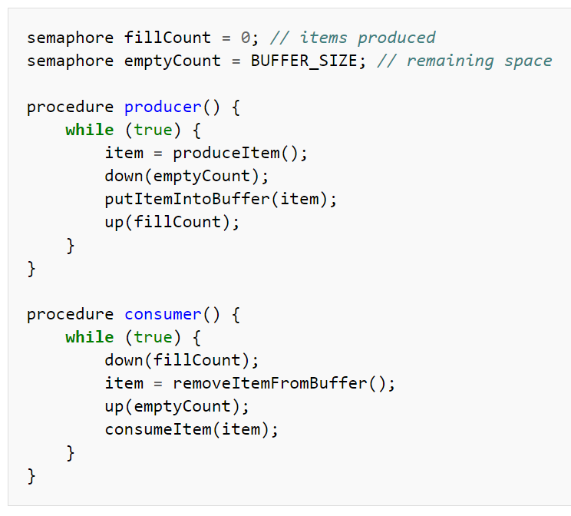
Producer consumer II
Works for single producer and consumer!
Why?
Notes:
imagine how the procedure putItemIntoBuffer() can be implemented. It could contain two actions, one determining the next available slot and the other writing into it. If the procedure can be executed concurrently by multiple producers, then the following scenario is possible:
Two producers decrement emptyCount
One of the producers determines the next empty slot in the buffer
Second producer determines the next empty slot and gets the same result as the first producer
Both producers write into the same slot

Slide 13
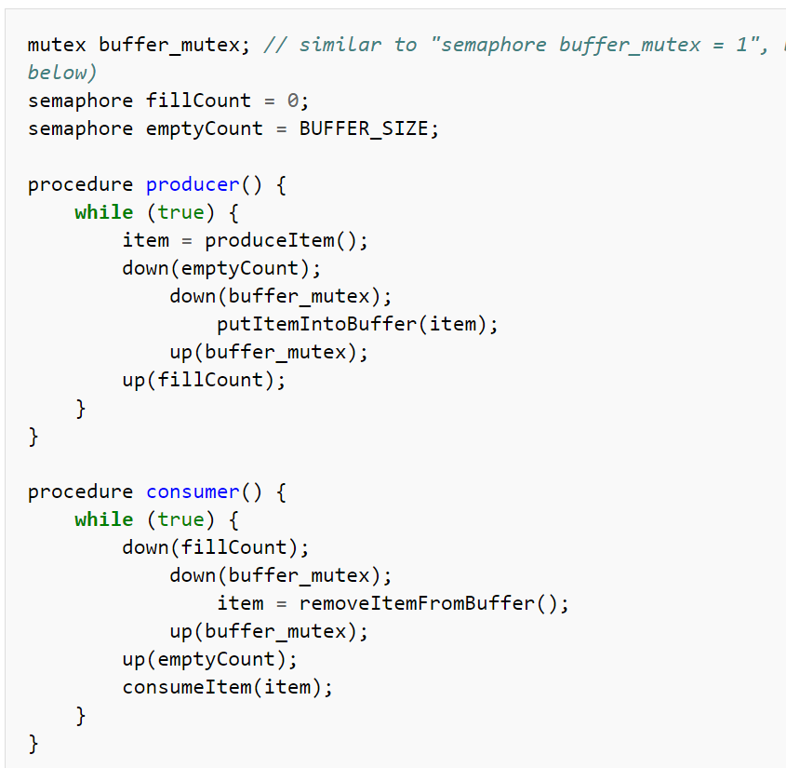
Producer consumer III
Works for multiple readers/writers
Why?

Slide 14
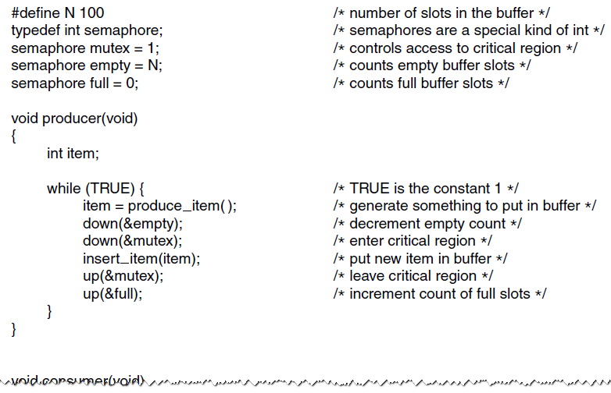
producer
The producer-consumer problem using semaphores.

Slide 15
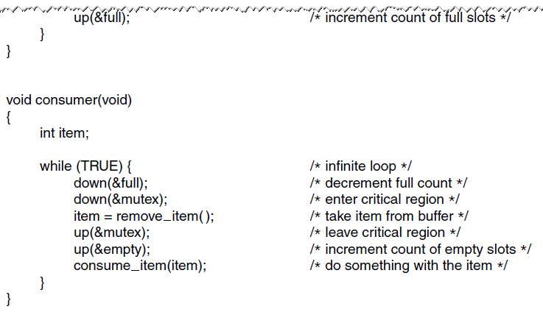
consumer
The producer-consumer problem using semaphores.

Slide 16
Readers/Writers Problem
A data area is shared among many processes
some processes only read the data area, (readers) and some only write to the data area (writers)
Conditions that must be satisfied:
any number of readers may simultaneously read the file
only one writer at a time may write to the file
if a writer is writing to the file, no reader may read it
Notes:
The readers/writers problem is defined as follows: There is a data area shared among a number of processes. The data area could be a file, a block of main memory, or even a bank of processor registers. There are a number of processes that only read the data area (readers) and a number that only write to the data area (writers). The conditions that must be satisfied are as follows:
1. Any number of readers may simultaneously read the file.
2. Only one writer at a time may write to the file.
3. If a writer is writing to the file, no reader may read it.
Thus, readers are processes that are not required to exclude one another and writers are processes that are required to exclude all other processes, readers and writers alike.

Slide 17
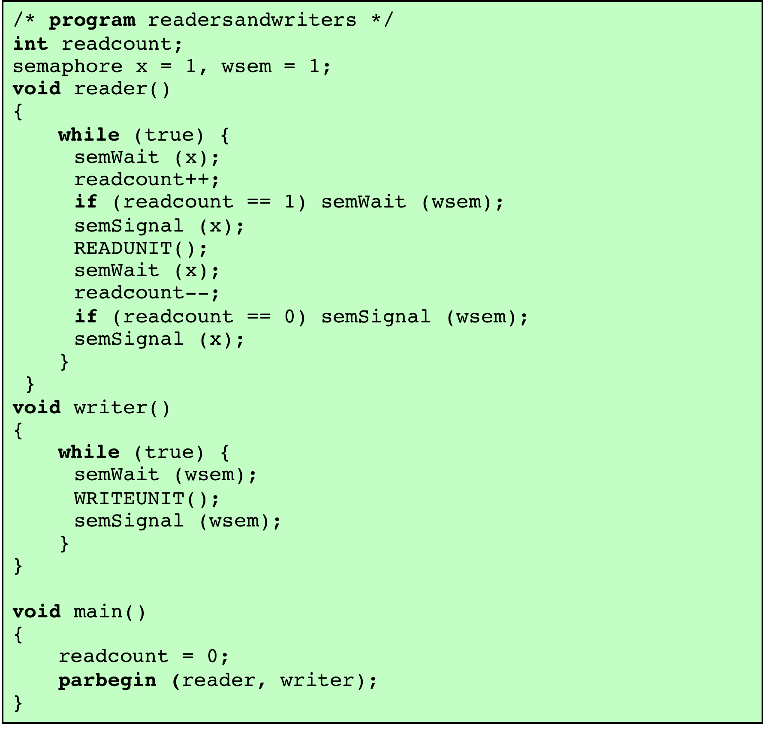
Figure 5.22
A Solution to the Readers/Writers Problem Using Semaphores: Readers Have Priority
Notes:
Figure 5.22 is a solution using semaphores, showing one instance each of a reader and a writer; the solution does not change for multiple readers and writers. The writer process is simple. The semaphore wsem is used to enforce mutual exclusion. As long as one writer is accessing the shared data area, no other writers and no readers may access it. The reader process also makes use of wsem to enforce mutual exclusion. However, to allow multiple readers, we require that, when there are no readers reading, the first reader that attempts to read should wait on wsem . When there is already at least one reader reading, subsequent readers need not wait before entering. The global variable readcount is used to keep track of the number of readers, and the semaphore x is used to assure that readcount is updated properly.

Slide 18
Table 5.6
State of the Process Queues for Program of Figure 5.23
Notes:
For readers, one additional semaphore is needed. A long queue must not be allowed to build up on rsem ; otherwise writers will not be able to jump the queue. Therefore, only one reader is allowed to queue on rsem , with any additional readers queuing on semaphore z , immediately before waiting on rsem . Table 5.6 summarizes the possibilities.

Slide 19
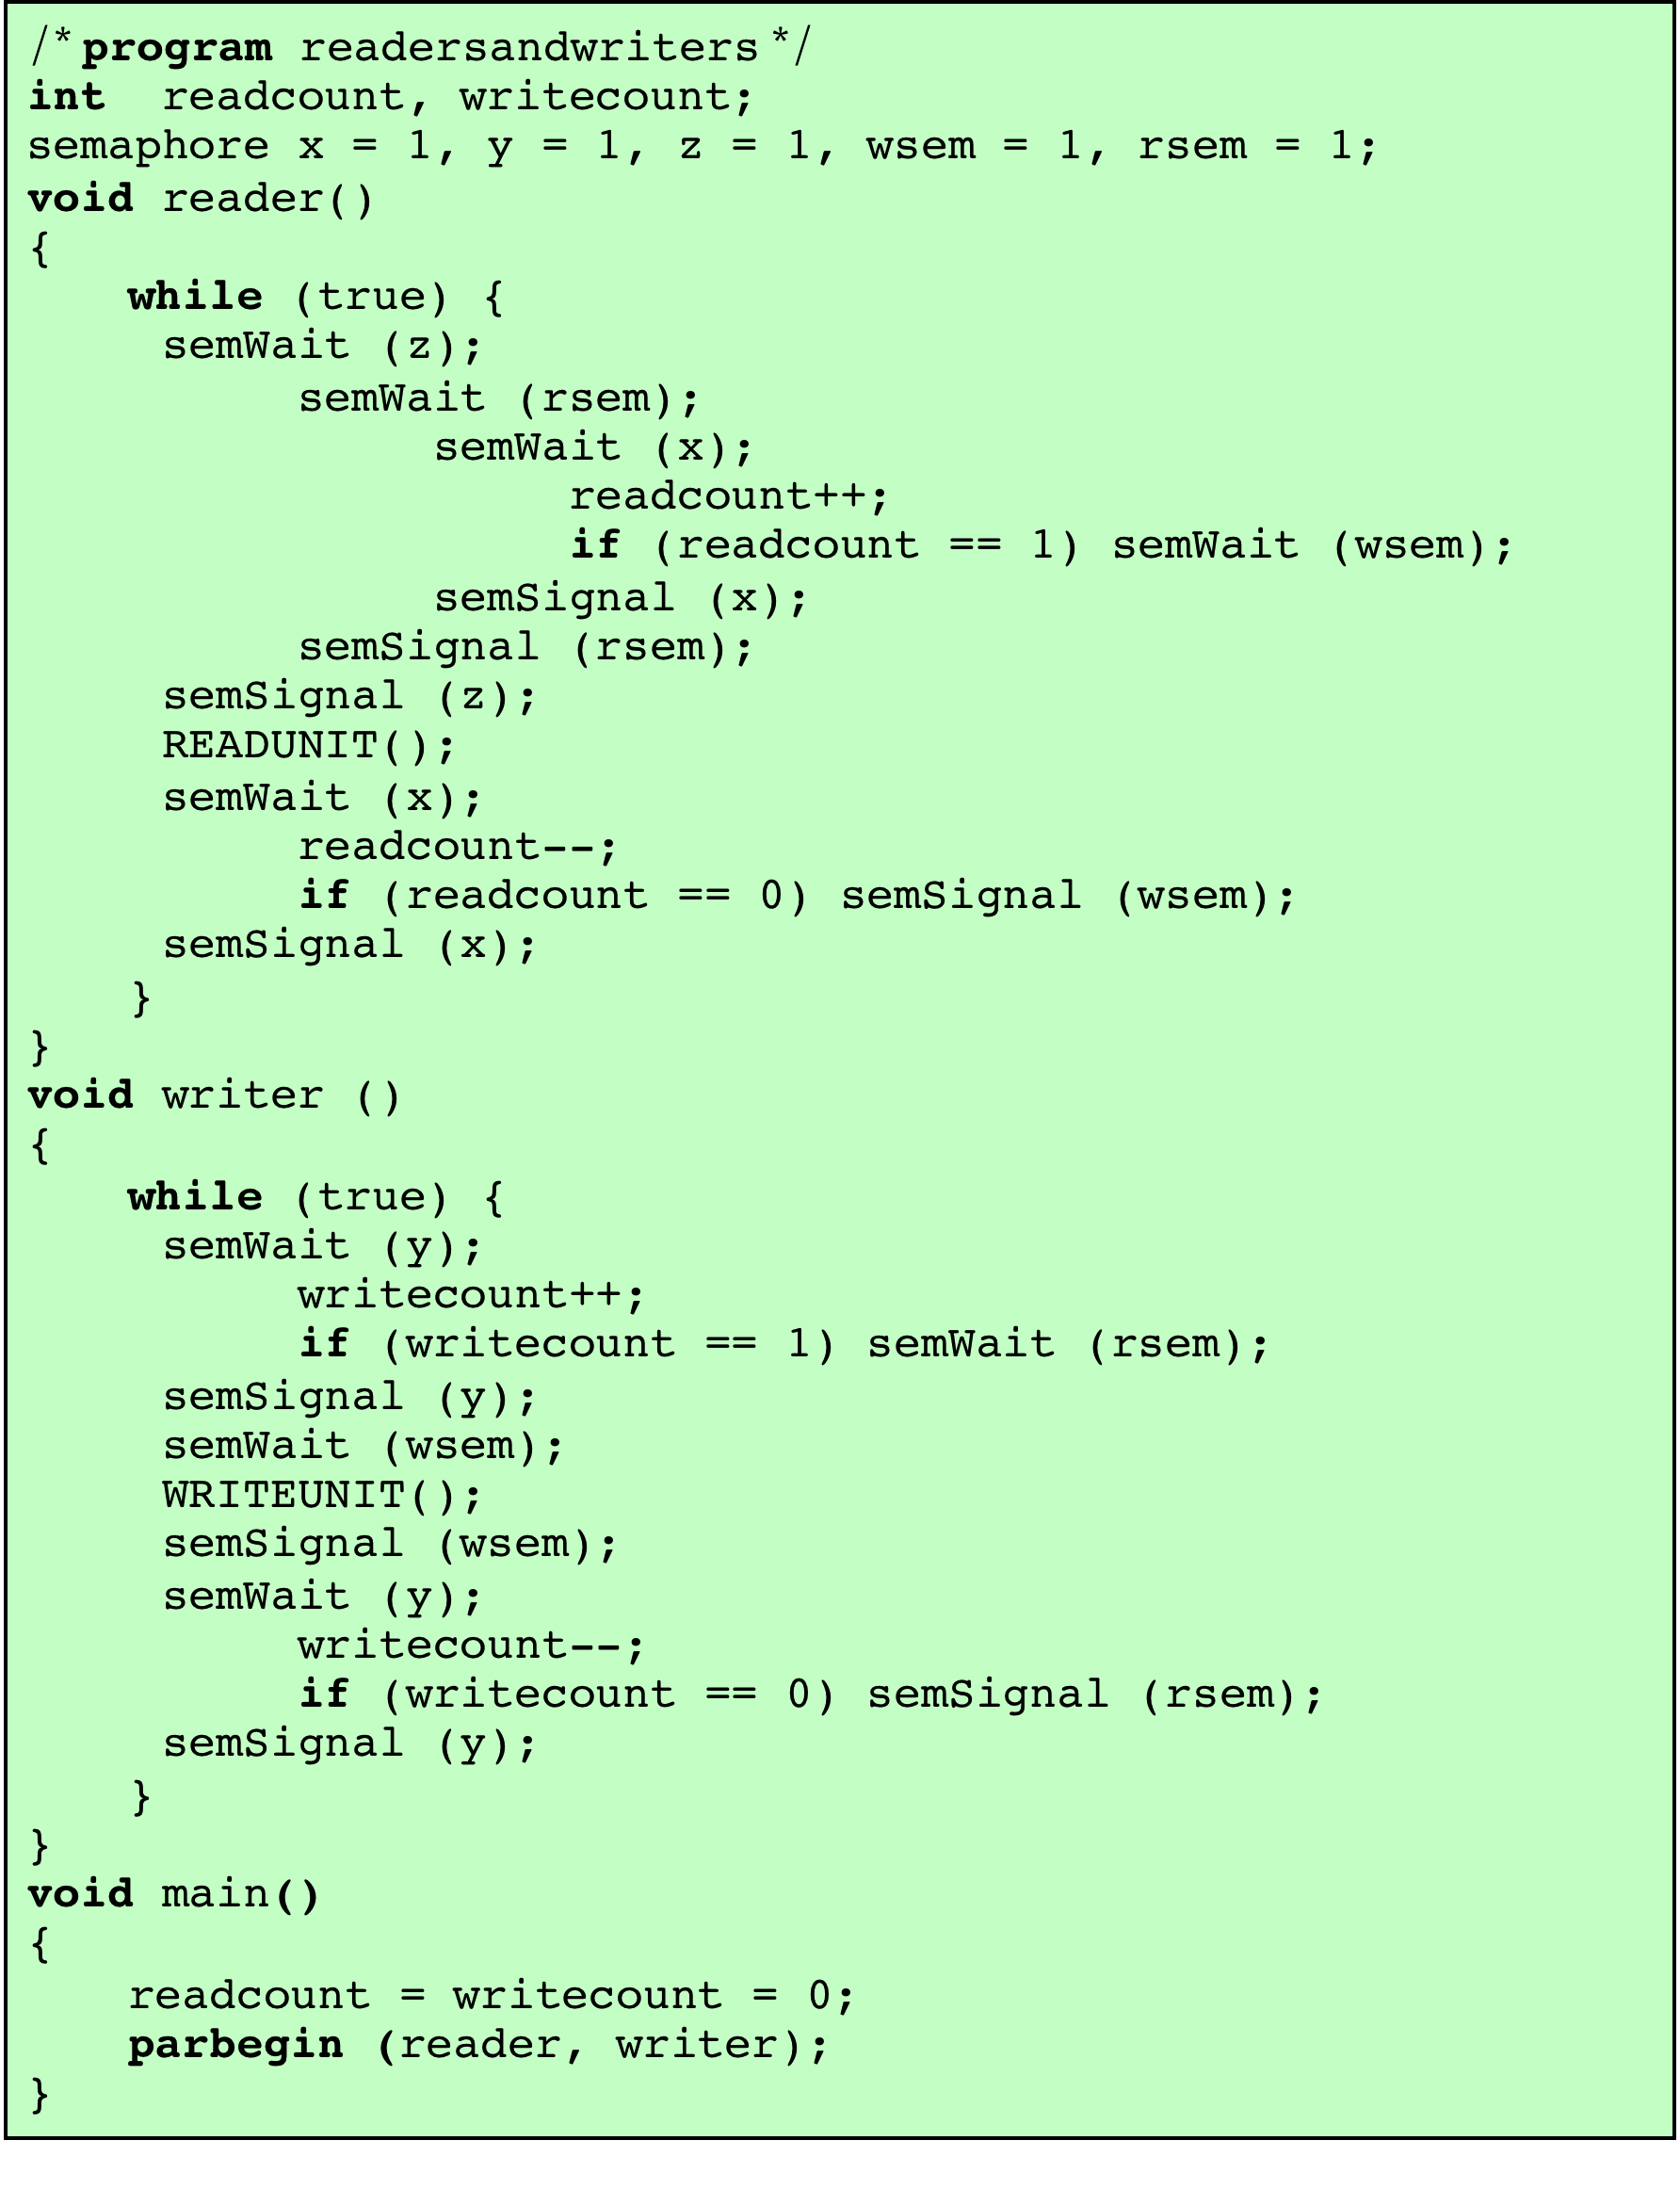
Figure 5.23
A Solution to the Readers/Writers Problem Using Semaphores: Writers Have Priority
Notes:
In the previous solution, readers have priority. Once a single reader has begun to access the data area, it is possible for readers to retain control of the data area as long as there is at least one reader in the act of reading. Therefore, writers are subject to starvation.
Figure 5.23 shows a solution that guarantees that no new readers are allowed access to the data area once at least one writer has declared a desire to write. For writers, the following semaphores and variables are added to the ones already defined:
• A semaphore rsem that inhibits all readers while there is at least one writer desiring access to the data area
• A variable writecount that controls the setting of rsem
• A semaphore y that controls the updating of writecount

Slide 20
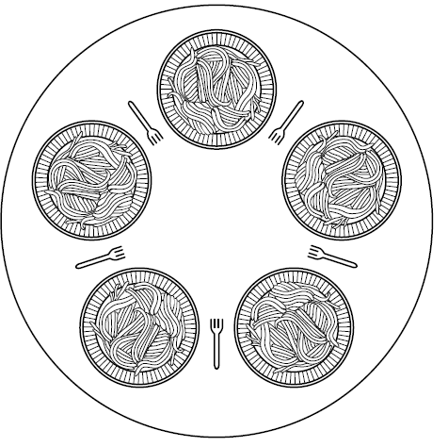
The Dining Philosophers Problem (1)
Figure 2-45. Lunch time in the Philosophy Department.

Slide 21
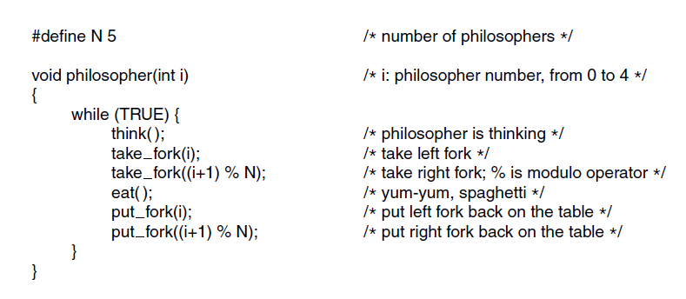
The Dining Philosophers Problem (2)
Solution to the dining philosophers problem?
Notes:
No. There is deadlock !!
They can all tak the left fork
Another option:
Wait for the

Slide 22
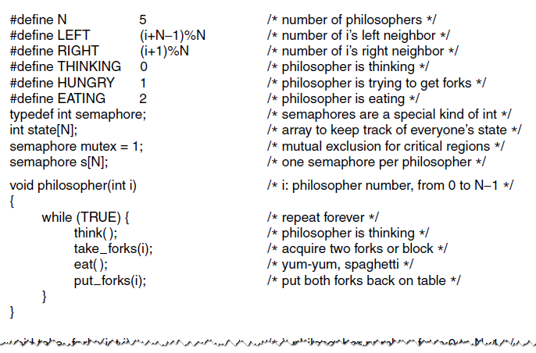
The Dining Philosophers Problem (3)
Figure 2-47. A solution to the dining philosophers problem.

Slide 23
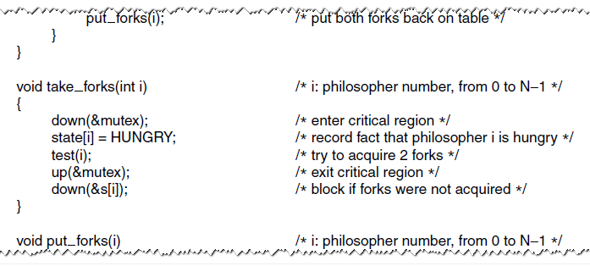
The Dining Philosophers Problem (4)
Figure 2-47. A solution to the dining philosophers problem.

Slide 24
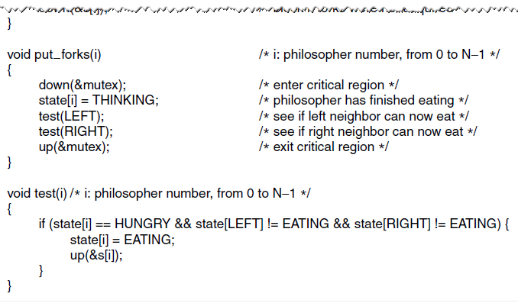
The Dining Philosophers Problem (5)
Figure 2-47. A solution to the dining philosophers problem.

Slide 25
A Second Solution to the Dining Philosophers Problem
Notes:
Figure 6.13 shows such a solution, again using semaphores. This solution is free of deadlock and starvation.

Slide 26
A Solution
to the
Dining
Philosophers Problem
Using a
Monitor
Notes:
Figure 6.14 shows a solution to the dining philosophers problem using a monitor. A vector of five condition variables is defined, one condition variable per fork. These condition variables are used to enable a philosopher to wait for the availability of a fork. In addition, there is a Boolean vector that records the availability status of each fork ( true means the fork is available). The monitor consists of two procedures. The get_forks procedure is used by a philosopher to seize his or her left and right forks. If either fork is unavailable, the philosopher process is queued on the appropriate condition variable. This enables another philosopher process to enter the monitor. The release-forks procedure is used to make two forks available. Note that the structure of this solution is similar to that of the semaphore solution proposed in Figure 6.12 . In both cases, a philosopher seizes first the left fork and then the right fork. Unlike the semaphore solution, this monitor solution does not suffer from deadlock, because only one process at a time may be in the monitor. For example, the first philosopher process to enter the monitor is guaranteed that it can pick up the right fork after it picks up the left fork before the next philosopher to the right has a chance to seize its left fork, which is this philosopher’s right fork.

Slide 27
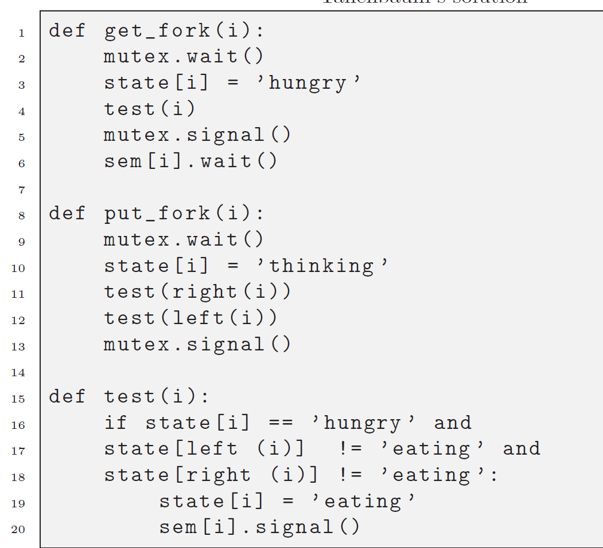
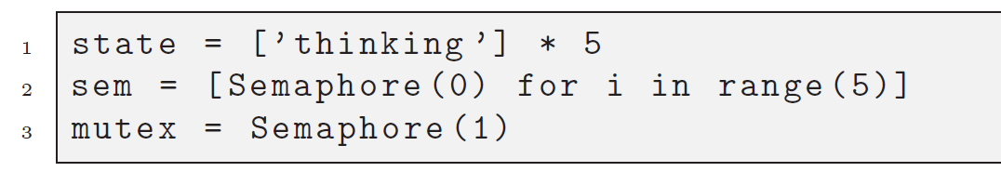
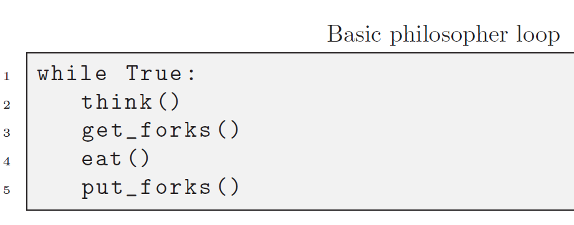
Dining philosopers solution (python)
Allen Downey version

Slide 28
Deadlock HANDLING

Slide 29
OUTLINE
Deadlocks
Definition
Conditions
Modeling
Detection & Recovery
Avoidance
Prevention
Other Issues
Starvation
Livelock
Two Phase Locking

Slide 30
OUTLINE
Deadlocks
Definition
Conditions
Modeling
Detection & Recovery
Avoidance
Prevention
Other Issues
Starvation
Livelock
Two Phase Locking

Slide 31
Deadlock Definition
We can define a deadlock more formally now: A set of processes is deadlocked if each process in the set is waiting for an event that only another process in the set can cause.

Slide 32
OUTLINE
Deadlocks
Definition
Conditions
Modeling
Detection & Recovery
Avoidance
Prevention
Other Issues
Starvation
Livelock
Two Phase Locking

Slide 33
Conditions for Deadlock
Mutual Exclusion
only one process may use a resource at a time
Hold-and-Wait
a process may hold allocated resources while awaiting assignment of others
No Pre-emption
no resource can be forcibly removed from a process holding it
Circular Wait
a closed chain of processes exists, such that each process holds at least one resource needed by the next process in the chain
Notes:
Three conditions of policy must be present for a deadlock to be possible:
1. Mutual exclusion . Only one process may use a resource at a time. No process may access a resource unit that has been allocated to another process.
2. Hold and wait . A process may hold allocated resources while awaiting assignment of other resources.
3. No preemption . No resource can be forcibly removed from a process holding it.
In many ways these conditions are quite desirable. For example, mutual exclusion is needed to ensure consistency of results and the integrity of a database. Similarly, preemption should not be done arbitrarily. For example, when data resources are involved, preemption must be supported by a rollback recovery mechanism, which restores a process and its resources to a suitable previous state from which the process can eventually repeat its actions.
The first three conditions are necessary but not sufficient for a deadlock to exist. For deadlock to actually take place, a fourth condition is required:
4. Circular wait . A closed chain of processes exists, such that each process holds at least one resource needed by the next process in the chain (e.g., Figure 6.5c
and Figure 6.6 ).
The fourth condition is, actually, a potential consequence of the first three. That is, given that the first three conditions exist, a sequence of events may occur that lead to an unresolvable circular wait. The unresolvable circular wait is in fact the definition of deadlock. The circular wait listed as condition 4 is unresolvable because the first three conditions hold. Thus, the four conditions, taken together, constitute necessary and sufficient conditions for deadlock.

Slide 34
OUTLINE
Deadlocks
Definition
Conditions
Modeling
Detection & Recovery
Avoidance
Prevention
Other Issues
Starvation
Livelock
Two Phase Locking

Slide 35
Modeling Deadlocks
We can model deadlock conditions as a directed graph
Two types of nodes: processes and resources
An edge from process -> resource indicates the process is blocked trying to acquire that resource
An edge from resource -> process indicates that the resource is currently held by the process

Slide 36
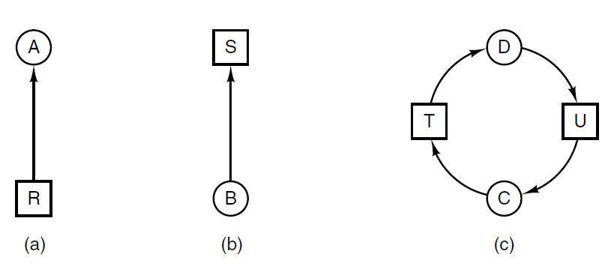
Deadlock Modeling
Resource allocation graphs.
Holding a resource.
Requesting a resource.
Deadlock.
Notes:
C is trying to get Resource T
T belongs to D
D is trying to get resource U
Resource U belongs to

Slide 37
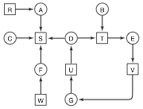
More Complicated

Slide 38
Dealing with Deadlocks
Many strategies for dealing with deadlocks in a system:
Do nothing, just make sure you're careful and hope you don't make any mistakes that lead to a deadlock
Detect and recover
Avoid deadlocks by being careful about how we hand out resources
Prevent deadlocks by negating one of the four conditions we saw earlier

Slide 39
Summary of Deadlock Detection, Prevention, and Avoidance
Approaches for Operating Systems [ISLO80]
Notes:
There is no single effective strategy that can deal with all types of deadlock. Table 6.1 summarizes the key elements of the most important approaches that have been developed: prevention, avoidance, and detection. We examine each of these in turn, after first introducing resource allocation graphs and then discussing the conditions for deadlock.

Slide 40
OUTLINE
Deadlocks
Definition
Conditions
Modeling
Detection & Recovery
Avoidance
Prevention
Other Issues
Starvation
Livelock
Two Phase Locking

Slide 41
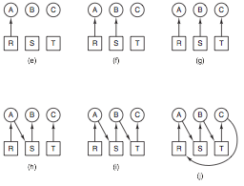
Deadlock Detection
We can see that having a deadlock is equivalent to having a cycle in our graph

Slide 42
Deadlock Detection
If we have only one resource of each type, we can simply check for a cycle in the dependency graph
Possible algorithms:
Use depth-first search starting from each node; if you reach the start node, there is a cycle; complexity O(V(V+E))
Tarjan's strongly connected components algorithm; complexity O(V+E)
Notes:
This can not capture whether we have multiple resources of the same kind

Slide 43
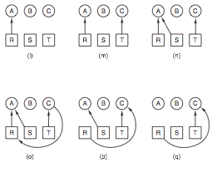
Deadlock Avoided

Slide 44
Deadlock Detection (Multiple Resources)
If we have more than one of some resources (for example: two disk drives), we need a different algorithm
Start with two vectors
Existing resources: (E1, E2, ..., Em)
Available resources: (A1, A2, ..., Am)

Slide 45
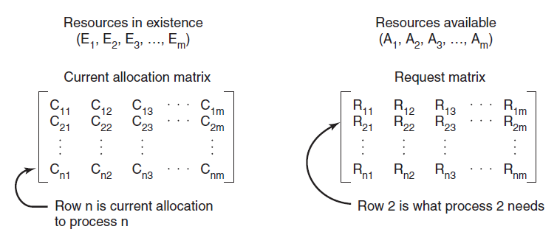
Allocation/Request Matrices
The four data structures needed by the deadlock detection algorithm.

Slide 46
Relations and Invariants
Satisfies:
In other words, the sum of the allocated and available counts for each resource class equals the total number of that resource class
For vectors A, B let A ≤ B mean that each element of A is less than or equal to the corresponding element in B A ≤ B <=> Ai ≤ Bi for 0 ≤ i ≤ m

Slide 47
Detecting Deadlock
Look for unmarked process, P_{i} , for which the i-th row of R is less than or equal to A.
If such a process is found, add the i-th row of C to A, mark the process, go back to step 1.
If no such process exists, algorithm terminates.

Slide 48
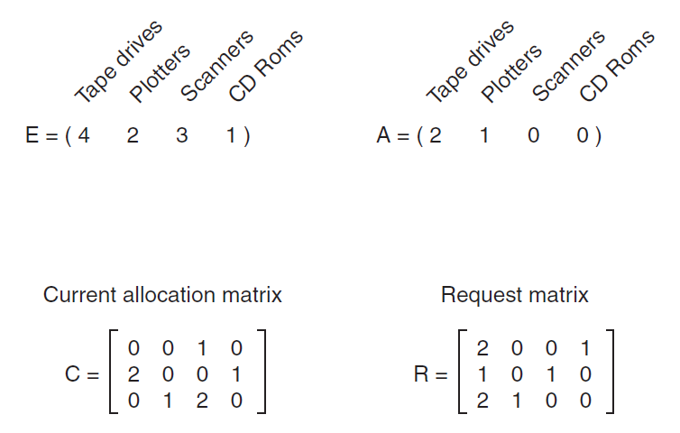
Worked Example

Slide 49
When to Check
Every time a resource request is made?
Quickest detection, but may be expensive
Every k minutes
When CPU usage is below X%
If everyone is deadlocked, they won't be using much CPU (assuming no busy-wait locks)

Slide 50
How to Recover
Preemption - Take away a resource temporarily, then give it back
Rollback - Periodically checkpoint processes, and if a deadlock occurs, roll back to before they tried to acquire a resource
Killing Processes - If we kill a process and reclaim its resources, others waiting on those resources can run

Slide 51
OUTLINE
Deadlocks
Definition
Conditions
Modeling
Detection & Recovery
Avoidance
Prevention
Other Issues
Starvation
Livelock
Two Phase Locking

Slide 52
Deadlock Avoidance
Usually processes only ask for resources one at a time
So if we can make good decisions at the time of resource acquisition, we can potentially avoid getting into a deadlock in the first place
Note: the following assumes that processes declare their maximum resource needs up front

Slide 53
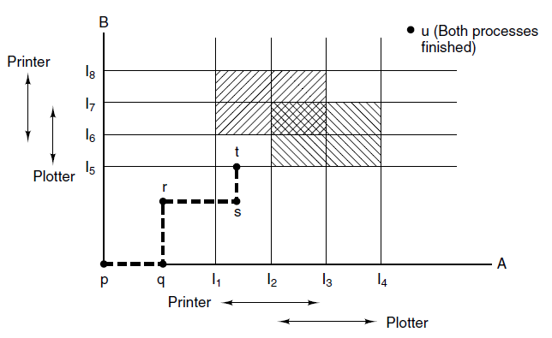
Resource Trajectories (Intuition)
Notes:
The algos for deadlock avoidance are based on the concept of safe states. Let’s take a look at the intuition

Slide 54
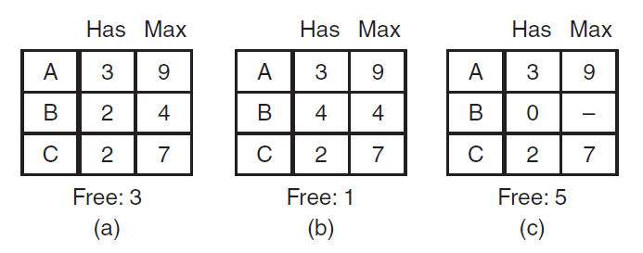
Safe and Unsafe States
A state is safe if there is some scheduling order that lets every process run, even if they all request their maximum number of resources at once
Suppose there are 10 instances of a resource. Then the state below is safe:

Slide 55
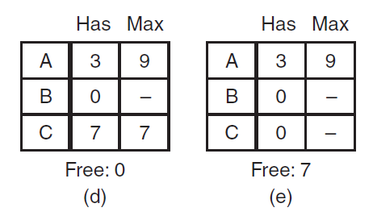
Safe State

Slide 56
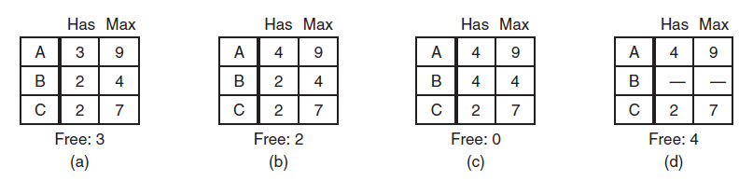
Unsafe State
Unsafe

Slide 57
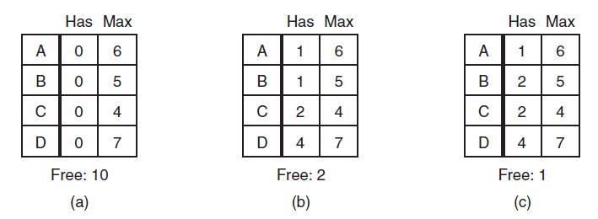
Banker's Algorithm
Essentially: check if granting a request would lead to an unsafe state, and deny it if so
Should we grant B's request here?
No

Slide 58
Banker's Algorithm (Multiple Resources)
We will use the resource matrices C and R again
Go through each process checking if running it could put the system into an unsafe state

Slide 59
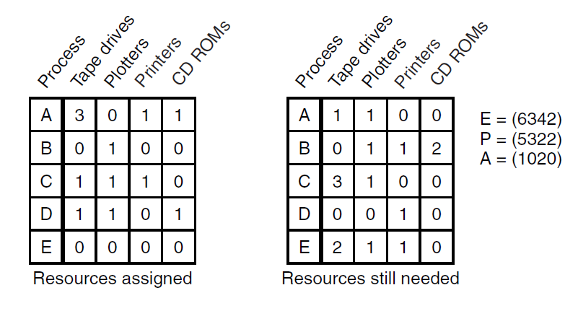
Example

Slide 60
Algorithm
Look for a row, R, whose unmet resource needs are all smaller than or equal to A. If no such row exists, system will eventually deadlock.
Assume the process of row chosen requests all resources needed and finishes. Mark that process as terminated, add its resources to the A vector.
Repeat steps 1 and 2 until either all processes are marked terminated (safe state) or no process is left whose resource needs can be met (deadlock)

Slide 61
Example
B asks for printer => SAFE
E asks for other printer => UNSAFE

Slide 62
Deadlock Avoidance in Practice
In reality, the constraint that every process declare its resource needs is unrealistic
Process dynamically grow and shrink their resource usage according to user demands
Processes start and stop dynamically, so there isn't a fixed set at once
Still, heuristic or approximate versions of this algorithm are sometimes used to make deadlocks less likely

Slide 63
OUTLINE
Deadlocks
Definition
Conditions
Modeling
Detection & Recovery
Avoidance
Prevention
Other Issues
Starvation
Livelock
Two Phase Locking

Slide 64
Deadlock Prevention
Instead of trying to detect and avoid deadlocks, we can try to make them impossible
We saw four conditions that are needed for deadlocks to occur
Mutual exclusion
Hold and wait
No preemption
Circular wait

Slide 65
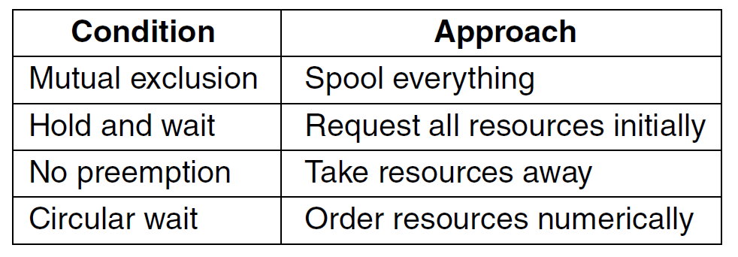
Attacking conditions

Slide 66
Attacking Conditions
Mutual exclusion – make data read only, or designate a single process to be the only owner of a resource
Often not practical
Hold and wait – require processes to request all of their resources at the beginning
If processes knew what resources they needed, we could use the banker's algorithm!
No preemption – ensure that all resources are pre-emptible
But this is effectively impossible in practice

Slide 67
Attacking Circular Wait
One way – only allow a process to have a single resource at a time (may make large transfers between two resources difficult)
Better: give each resource a unique number, and require that requests be made in numerical order

Slide 68
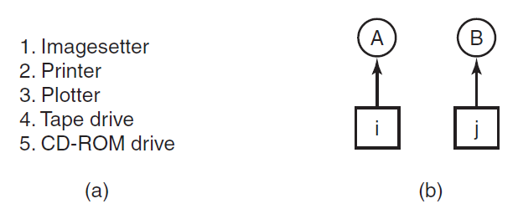
Attacking Circular Wait
Deadlock will occur here if A requests j and B requests i
So A will request resources in the order i, j
B will request resources in the order j, i
But since i ≠ j, one of these must violate the requirement to acquire resources in order

Slide 69
Attacking Circular Wait
Minor variation: only have to request resource numbered higher than currently held resource numbers
These successfully avoid deadlock
But it may be difficult to find an ordering that satisfies all processes

Slide 70
OUTLINE
Deadlocks
Definition
Conditions
Modeling
Detection & Recovery
Avoidance
Prevention
Other Issues
Starvation
Livelock
Two Phase Locking

Slide 71
starvation
Processes need resources
OS allocates resources based on a policy
Sometimes this policies lead to a process never getting the resource => Starvation
Can be avoided using FIFO policy
Examples:
Dining Philosophers
Printing a large file

Slide 72
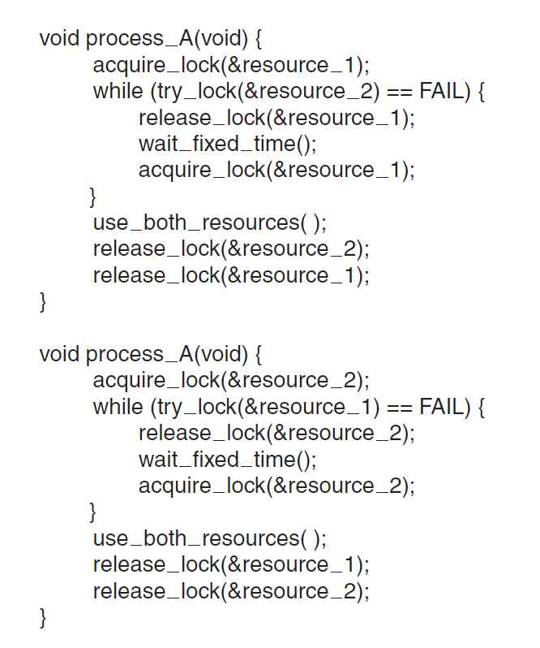
Livelock
void process_B(void) {

Slide 73
Two phase locking
Used in database systems
Algorithm:
Try to lock all the records it needs one by one
If success perform updates and release the locks. No work done in first phease.
If fail: release all locks and start again.
Problems:
Real time systems
Network

